Slide 1
Full Stack Healthcare Appointment and Patient Management Platform
160923733307 – Mohammed Moiz
160923733310 – Mohammed Farhan
160923733311 – Mohammed Sameer
160923733312 – Mohammed zubair

Slide 2
Introduction
Healthcare institutions manage large amounts of patient information, doctor schedules, and appointments. Traditional appointment systems often depend on phone calls, paperwork, and manual record maintenance, which can cause delays, scheduling conflicts, and difficulties in managing patient information.
The research papers explore digital appointment scheduling, patient management, AI-based healthcare support, and real-time hospital systems.
The proposed project aims to develop a Java-based Full Stack Healthcare Appointment and Patient Management Platform that provides a centralized system for patients, doctors, and administrators.

Slide 3
Literature Survey
1. Intelligent Patient Appointment Schedules (2026)
Proposes AI-based appointment scheduling using BioBERT-BiLSTM for symptom analysis and specialist recommendation.
Simulation reduced booking time from 155 minutes to 5.73 minutes.
Limitation: Requires real-world clinical validation.
2. Smart Doctor Appointment Booking and Patient Management System Using MERN Stack (2026)
Develops a web application for patient registration, doctor availability, appointment booking, and medical records.
Limitation: Limited evidence of long-term clinical deployment.

Slide 4
3. Digital Service Platform and Innovation in Healthcare (2023)
Evaluates patient satisfaction with an electronic appointment system.
Finds that website quality and service quality did not meet patient expectations.
Limitation: Study focuses on one hospital.
4. A Multi-Appointment Patient Scheduling System with Machine Learning and Optimization (2024)
This research focuses on improving outpatient appointment scheduling, particularly for chemotherapy patients.
Limitation: Requires careful clinical safety controls for AI recommendations.
5. Design and Development of a Web-Based Patient Management Information System (2024)
The research paper focuses on developing a web-based patient management information system to improve hospital services and administrative activities.
Limitation: Further improvements are needed in telehealth, payments, and security.

Slide 5
Literature Survey Comparison Table
Research Paper | Main Contribution | Limitations Identified
Intelligent Patient Appointment Schedules (2026) | Uses AI-based scheduling to analyse symptoms and recommend specialists. | Simulation-based results require real-world validation.
Smart Doctor Appointment Booking and Patient Management System Using MERN Stack (2026) | Provides patient registration, doctor availability, appointment booking, and patient record management. | Limited evidence of long-term clinical deployment.
Digital Service Platform and Innovation in Healthcare (2023) | Evaluates patient satisfaction with an electronic hospital appointment service. | Website quality and service quality did not meet patient expectations.
A multi-appointment patient scheduling system with machine learning and optimization | Uses Artificial Neural Networks and optimization for patient scheduling. | No single preprocessing method works best in every condition.
Design and development of a web-based patient management information system | Develops a web-based hospital management system. | May not address all real-world lighting conditions

Slide 6
Research Gaps Identified
The paper does not clearly provide detailed real-world hospital deployment results or long-term performance evaluation.
The paper does not provide sufficient evidence of how the system performs under high patient traffic or large hospital workloads.
The study found that website quality and service quality did not meet patient expectations.
Incorrect or incomplete symptom descriptions may result in unsuitable specialist recommendations.
A separate mobile application is suggested as future work to improve accessibility.
Overall Research Gap
There is a need for a centralized, secure, and user-friendly healthcare platform that combines patient management, doctor management, and appointment scheduling, with proper data protection and practical testing in a healthcare environment.

Slide 7
Proposed System
A Java-based web application that provides centralized healthcare appointment and patient management.
Patient Module: Register, search doctors, book appointments, and view appointment history.
Doctor Module: Manage profiles, availability, and appointments.
Admin Module: Manage patients, doctors, and appointments.
Key Benefits:
Easy online appointment booking.
Centralized patient records.
Better doctor schedule management.
Reduced manual work.

Slide 8
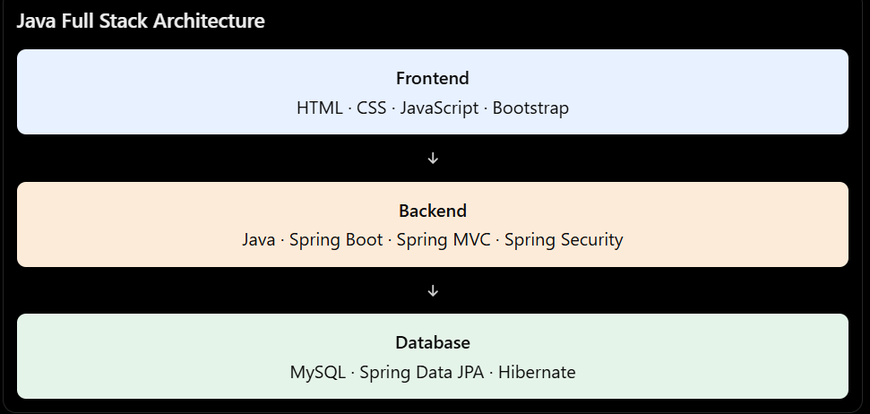
Proposed Technology Stack

Slide 9
IEEE References
[1] S. Elhag, L. Althagafi, and S. Almouabdi, “Intelligent Patient Appointment Schedules,” Healthcare, vol. 14, Art. no. 1195, 2026, doi: 10.3390/healthcare14091195.
[2] A. Das, S. Sahoo, and S. S. Sarangi, “Smart Doctor Appointment Booking and Patient Management System Using MERN Stack,” American Journal of AI Cyber Computing Management, vol. 6, no. 2(2), 2026.
[3] F. Kitsios, S. Stefanakakis, M. Kamariotou, and L. Dermentzoglou, “Digital Service Platform and Innovation in Healthcare: Measuring Users’ Satisfaction and Implications,” Electronics, vol. 12, Art. no. 662, 2023, doi: 10.3390/electronics12030662.
[4] J. Jeshma, P. Asha A. S., and M. Mahishma, “Smart Healthcare Appointment and Patient Management System: An AI-Driven Approach to Intelligent Scheduling and Care Coordination,” International Journal of Engineering Research & Technology (IJERT), vol. 15, no. 7, Jul. 2026.
[5] S. Tirpude, D. Chudasama, and M. Kharat, “MediConnect: A Full-Stack Real-Time Hospital Appointment Management System,” International Journal for Research in Applied Science & Engineering Technology (IJRASET), vol. 14, no. IV, Apr. 2026, doi: 10.22214/ijraset.2026.80561.

Slide 10
Thank you

